Slide 1
RDC Amenity Survey: Top Categories and Sub-categories Report
July 1 through July 19, 2018
(via Survey Monkey)
Amenities Advisory Panel:
Chris England, Karen LeBon, Bob Stout, John Pittman, Dallas Eckard,
Fred Wallace, Greg Van Zandt

Slide 2
Terminology
Weighted Response: we took the two top ratings (dependent on the question type) :
% Very important and Important
% Needs significant improvement and Needs some improvement
% Very interested and Somewhat interested
We then combined them as one overall % giving a weighting to separate topics that are not of interest from those of greater interest.
Subcategory color depiction:
Green: Top categories
Yellow: Categories very close in response %
Blue: Other lower rated categories

Slide 3
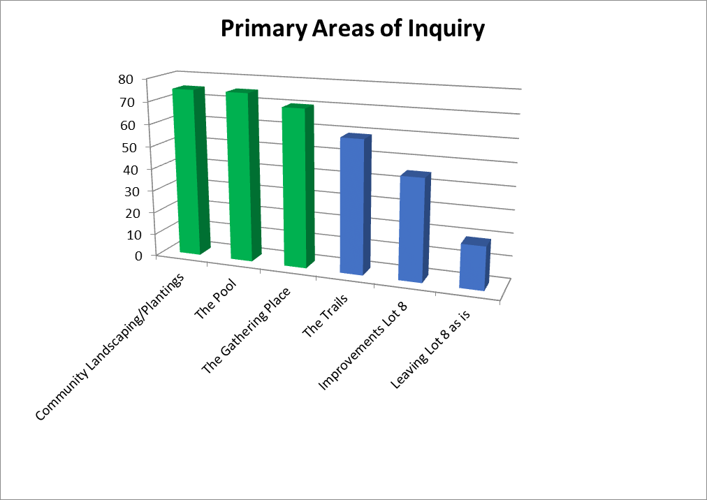
Primary Areas of Interest
Weighted Top Responses
3 Top Areas of Interest

Slide 4
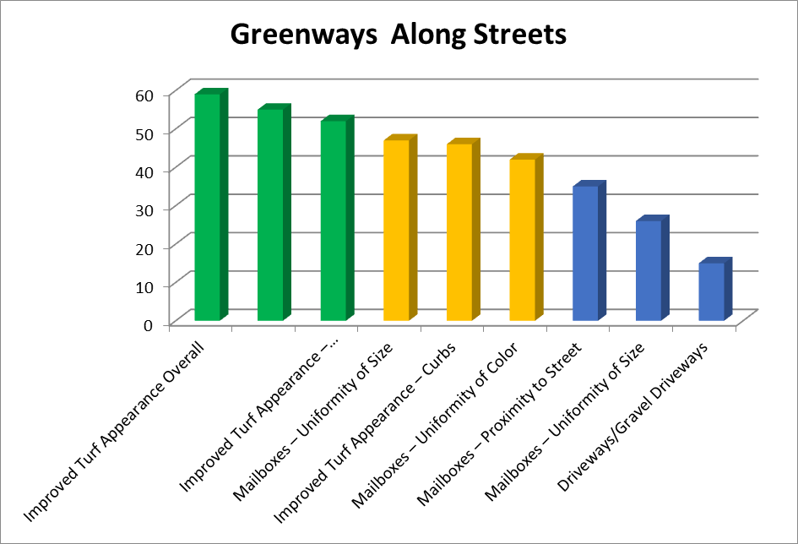
Community Landscaping and Plantings: Greenways Along Streets
Weighted Subcategory Responses
Key Subcategories

Slide 5
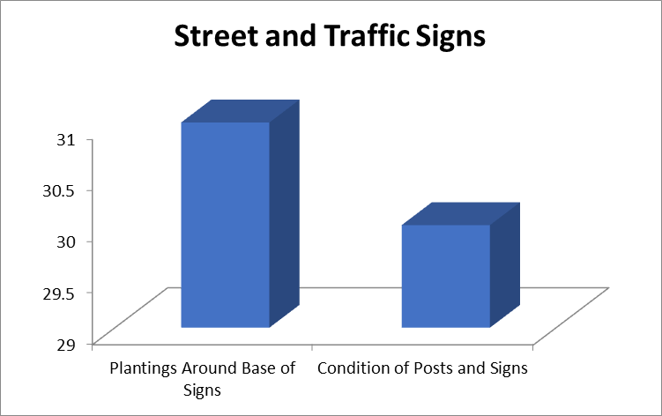
Community Landscaping and Plantings: Street & Traffic Signs
Weighted Subcategory Responses
Key Subcategories

Slide 6
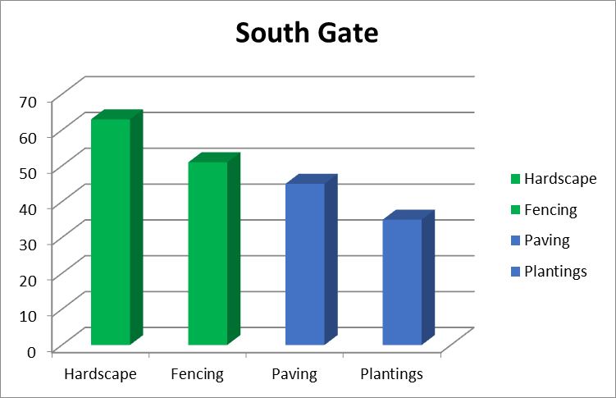
Community Landscaping and Plantings: South Gate
Weighted Subcategory Responses
Key Subcategories

Slide 7
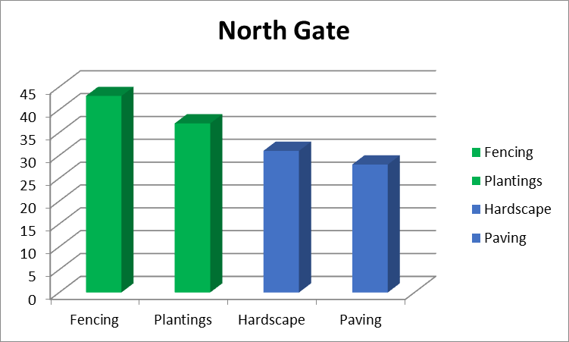
Community Landscaping and Plantings: North Gate
Weighted Subcategory Responses
Key Subcategories

Slide 8
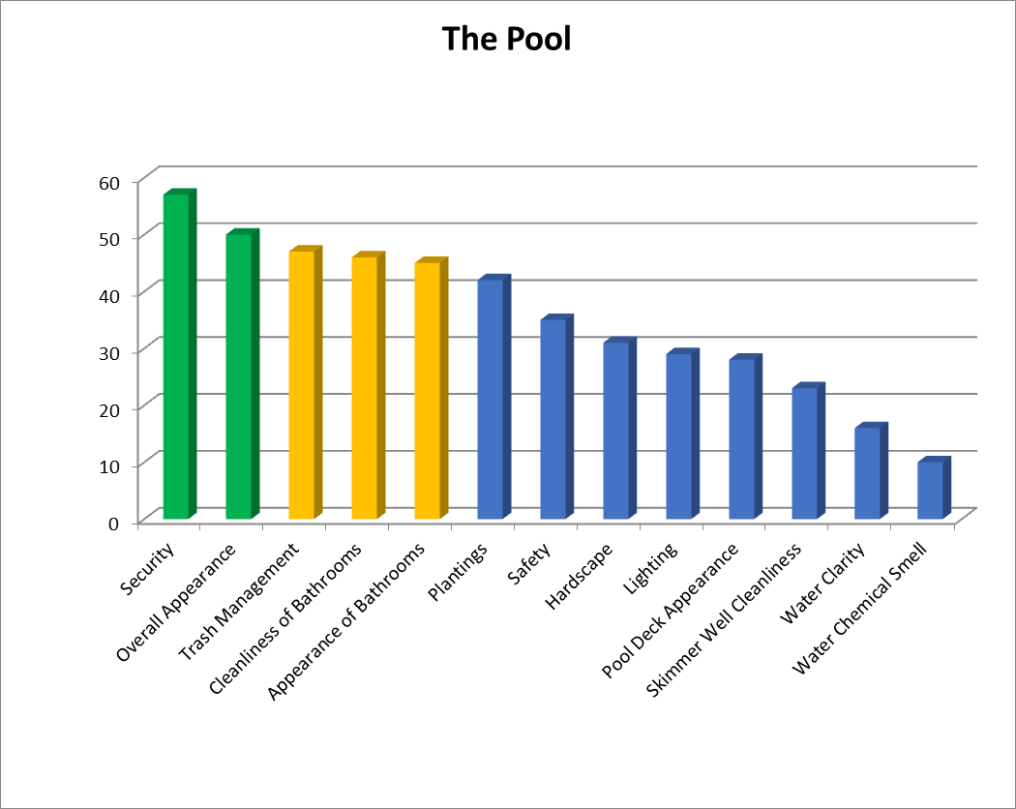
The Pool
Weighted Subcategory Responses
Key Subcategories

Slide 9
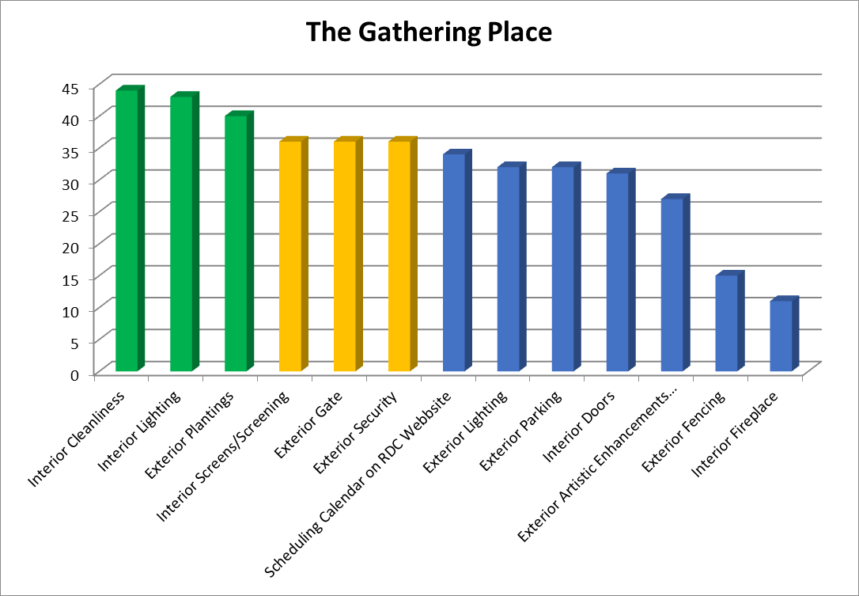
The Gathering Place
Weighted Subcategory Responses
Key Subcategories

